Slide 1

Scrum Master Training
Vedavit Project Solutions
Notes:
1
Click to add notes

Slide 2
Agenda
Background
Scrum Overview
Daily Scrum
Ceremonies
Roles
Artifacts
Estimation
Task Boards
Scaling Scrum

Slide 3
Background
Defined vs Empirical Processes
Predictive vs Adaptive Plans
Complex Adaptive Systems

Slide 4
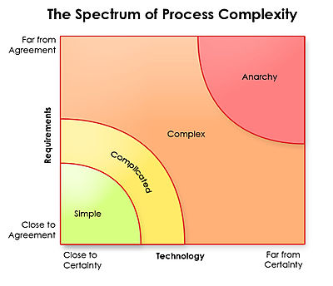
Which PM Methodology is best?
Nothing works here
Ralph Stacey's complexity matrix
Waterfall

Slide 5


Agile Manifesto
Individuals and interactions
Process and tools
over
Working software
Comprehensive documentation
over
Customer collaboration
Contract negotiation
over
Responding to change
Following a plan
over
Source: www.agilemanifesto.org

Slide 6
Agile Principles
Satisfy customer by continuous delivery of valuable product
Welcome Change even at late stage
Deliver working software Frequently
Business and Developer work together
Build around Motivated Individuals- Give team opportunity, trust them
Face-to-face communication
Working software is the primary measure of progress.
Sustainable Development
Continuous Technical Excellence
Simplicity--the art of maximizing the amount of work not done--is essential.
Self Organizing Team
Team reflection at regular intervals
www.agilemanifesto.org

Slide 7
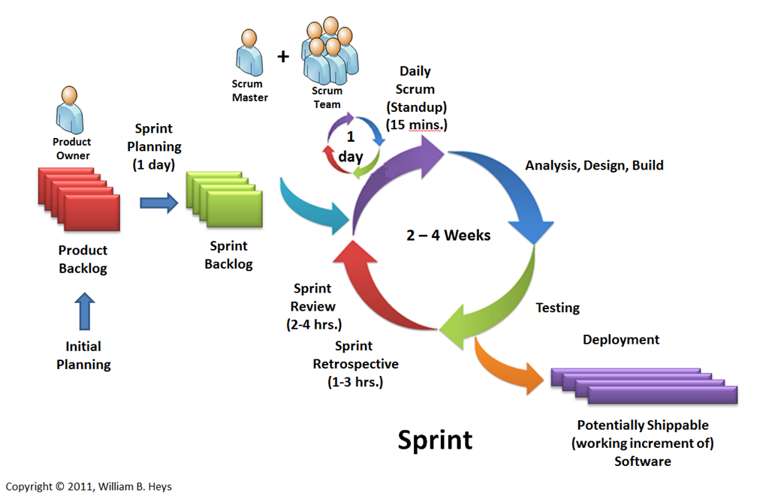
Scrum Overview

Slide 8
Daily Scrum
Who participates there? Committed only & not involved
This is information sharing session. NOT reporting session.
What did you do yesterday?
What will you do today?
Are there any impediments in your way?

Slide 9
Sprint Planning
There are two defined artifacts that result from a sprint planning meeting:
A sprint goal
A sprint backlog
Example of sprint goal
Implement basic shopping cart functionality including add, remove, and update quantities.
Develop the checkout process: pay for an order, pick shipping, order gift wrapping, etc.

Slide 10
Sprint Review Meetings
At the end of each sprint, a sprint review meeting is held. During this meeting, the Scrum team shows what they accomplished during the sprint. Typically this takes the form of a demo of the new features. NO PPT Presentation.
Include the product owner, the Scrum team, the ScrumMaster, management, customers and developers from other projects

Slide 11
Sprint Retrospectives
Start doing
Stop doing
Continue doing

Slide 12
Product Backlog
A typical Scrum backlog comprises the following different types of items:
Features
Bugs
Technical work
Knowledge acquisition

Slide 13
Example of User Story in Product Backlog
Every user story should have business value assigned by PO
Every user story should have minimum one customer
User should satisfy INVEST model
Format of any user story should be
As a …… I want to …………… so that I can ………….

Slide 14
Product Owner Role
Develop vision of what he or she wishes to build, and convey that vision to the scrum team
Prioritize
Available to team for discussions
Justify ROI
Accepts or rejects work results

Slide 15
Scrum Master
Responsible for making sure a Scrum team lives by the values and practices of Scrum
The ScrumMaster is often considered a coach for the team, helping the team do the best work it possibly can.
The ScrumMaster can also be thought of as a process owner for the team, creating a balance with the project's key stakeholder, who is referred to as the product owner
Removes external impediments

Slide 16
Scrum Team
Team size 7 +/- 2
Self Organizing Team (no titles)
Everyone on the project works together to complete the set of work they have collectively committed to complete within a sprint
No specialized skills like programmer, developer, architect

Slide 17
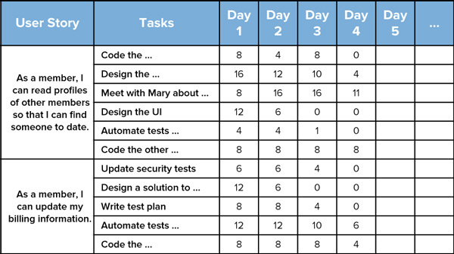
Sprint Backlog

Slide 18
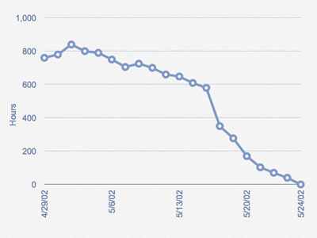
Sprint Burndown Chart

Slide 19
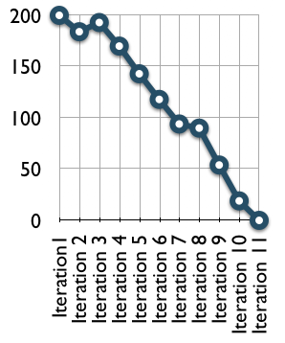
Release Burndown Chart
Story Points

Slide 20
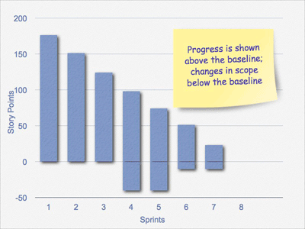
Release Burndown Bar Chart

Slide 21
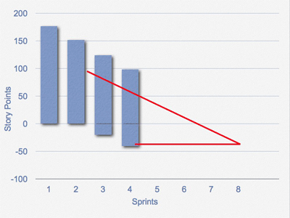
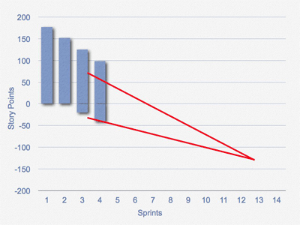
Release Burndown Bar Chart & Prediction

Slide 22
Estimation
Planning Poker
Relative Size Estimation
Affinity Estimation

Slide 23
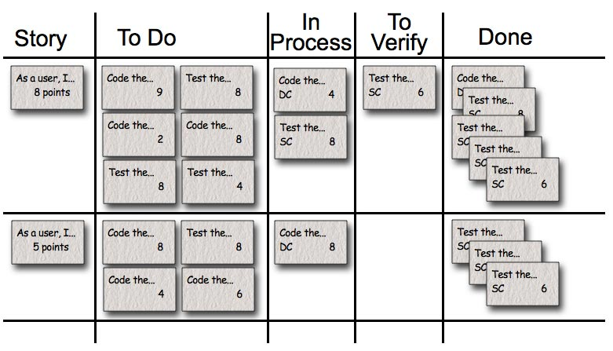
Task Board

Slide 24
Scaling Scrum
Typical individual team is 7 ± 2 people
Scalability possible using feature teams
Factors in scaling
Type of application
Team size
Team dispersion
Project duration
Scrum has been used on multiple 500+ person projects

Slide 25











Scrum of Scrum of Scrum

Slide 26
Further Readings
Agile Estimating and Planning, Author: Mike Cohn, ISBN #0131479415
Agile Project Management with Scrum, Author: Ken Schwaber, ISBN #073561993X
Agile Project Management:Creating Innovative Products –2nd Edition, Author: Jim Highsmith, ISBN #0321658396
Agile Retrospectives: Making Good Teams Great, Author: Esther Derby, Diana Larsen,KenSchwaber, ISBN #0977616649
Agile Software Development:The Cooperative Game –2nd Edition, Author: Alistair Cockburn, ISBN #0321482751
Becoming Agile in an imperfect world, Author: Greg Smith, Ahmed Sidky, ISBN #1933988258
Coaching Agile Teams, Author: Lyssa Adkins, ISBN #0321637704
Lean-Agile Software Development:AchievingEnterprise Agility, Author: Alan Shalloway,GuyBeaver,JamesR.Trott,ISBN#0321532899
The Art of Agile Development, Author: James Shore, ISBN #0596527675
The Software Project Manager’s Bridge to Agility, Author: Michele Sliger, Stacia Broderick, ISBN #0321502752
User Stories Applied:For Agile Software Development, Author: Mike Cohn, ISBN #0321205685
Agile Software Development Ecosystems by Jim Highsmith
Agile Software Development with Scrum by Ken Schwaber and Mike Beedle
Scrum and The Enterprise by Ken Schwaber
Succeeding with Agile by Mike Cohn

Slide 27

Hari P Thapliyal,
PMO Architect & Project Management Trainer
Reach Me:
hari.prasad@vedavit-ps.com
Skype: hari.thapliyal, YM: hari_thapliyal, Twitter: harithapliyal
Mobile: +91 9535999336
Profile: http://in.linkedin.com/in/harithapliyal
Blog: http://pmlogy.com/justgodonly/
http://pmlogy.com/projectislifeplus/
Website: www.pmlogy.com

